Slide 1
Recommender system
Amela Špica

Slide 2

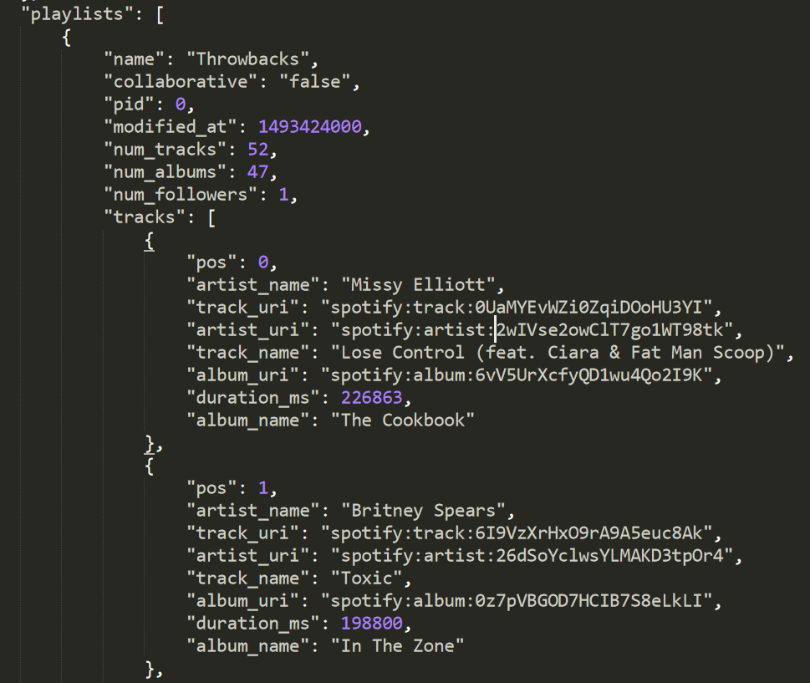
Challenge
Recommend tracks for given playlist
Dataset consists of 11 000 playlists
Dataset is given in JSON format
Example:

Slide 3
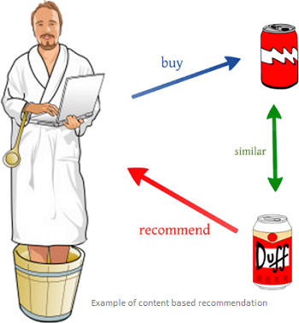
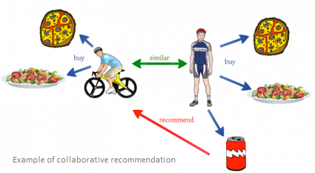
How recommender systems work?
Content-based systems
Recommend based on item properties
Problem of overspecialization
Collaborative filtering systems
Recommend based on similarity measures between users and/or items
Problem with bias towards popular items
Hybrid models

Slide 4
Collaborative filtering
Use k-nearest neighbours (kNN) to construct a recommendation
Neighborhood algorithms:
Item-based: based on the similarity between items calculated using user's ratings of those items
User-based: make item recommendation based on the similarity between users
Measure similarity – Jaccard distance, Cosine distance

Slide 5
Solution
Find k-nearest neighbours of given playlist
Measure similarity
Problems:
Data is in JSON (we need data in a matrix for calculating similarity)
With this much data making a matrix will be computationally intensive
Even if we make it, matrix would be sparse
How to solve these problems???

Slide 6

Elasticsearch
Full-text search and indexing engine with an HTTP web interface and schema-free JSON documents based on Apache Lucene
Find 100 similar playlists
Use TF/IDF to calculate score for similarity

Slide 7
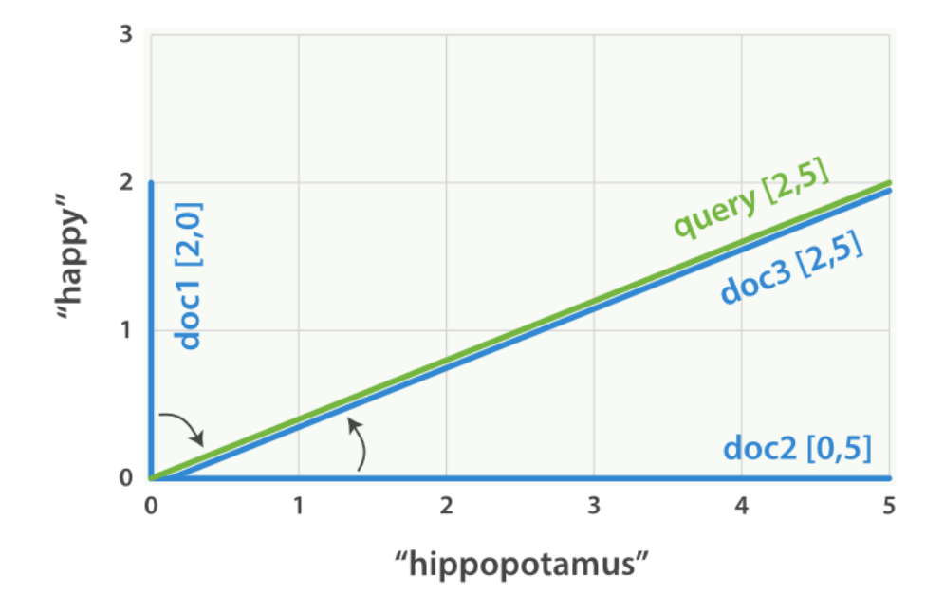
Term Frequency/ Inverse Document Frequency (TF/IDF)
Term frequency - How often does the term appear in this document?
The more often, the higher the weight.
Inverse document frequency - How often does the term appear in all documents in the collection?
The more often, the lower the weight.
Example: We have three documents. We want to find words „happy“ and „hippopotamus“. A common word like „happy“ will have a low weight, while an uncommon termn like „hippopotamus“ will have a high weight. Let‘s assume that „happy“ has weight 2 and „hippopotamus“ has a weight of 5.
I am happy in summer. (happy, _) – [2, 0]
After Christmas I’m a hippopotamus. (_, hippopotamus) – [0, 5]
The happy hippopotamus helped Harry. (happy, hippopotamus) – [2, 5]

Slide 8
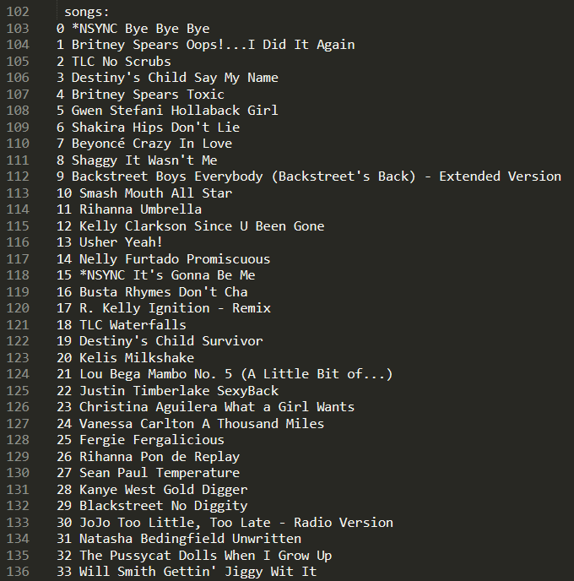
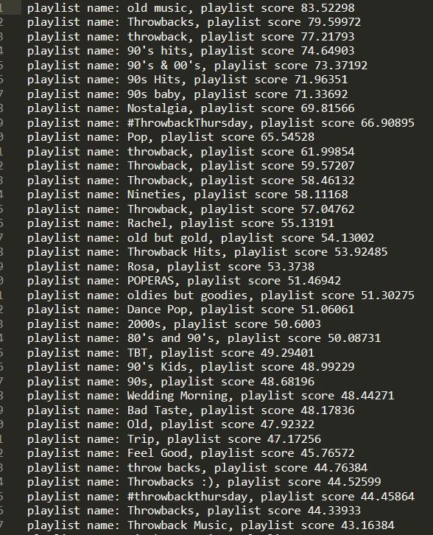
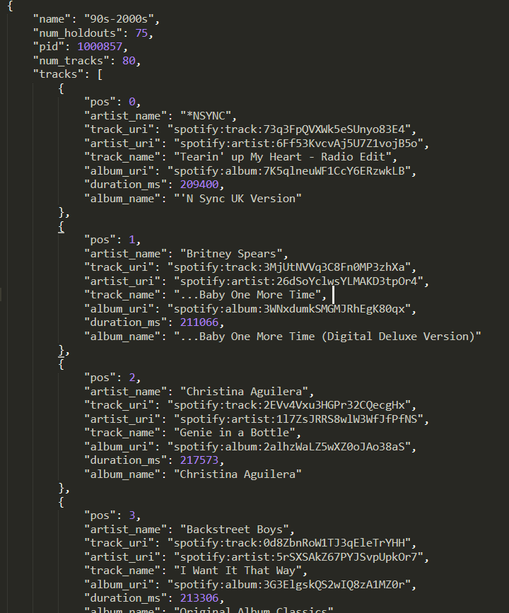
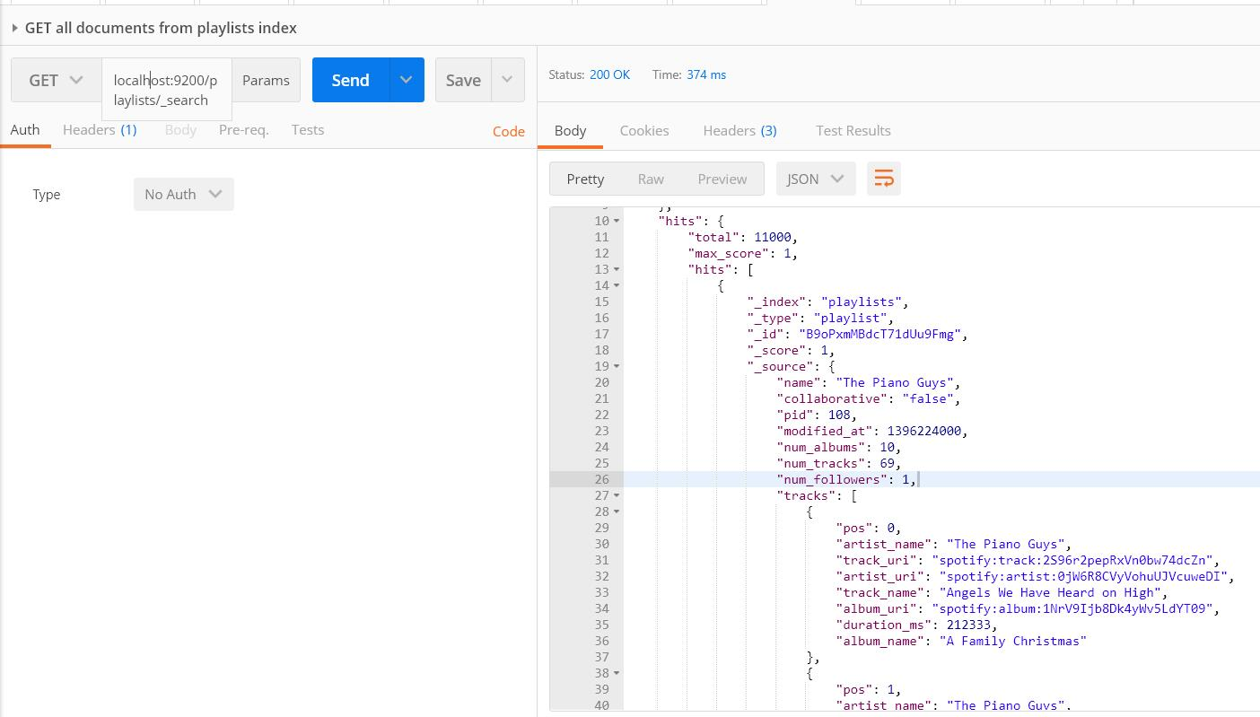
Results

Slide 9
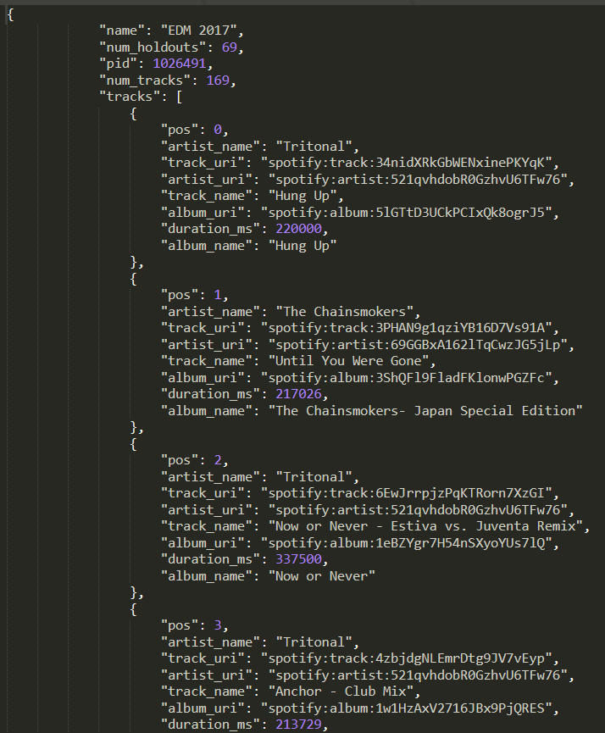
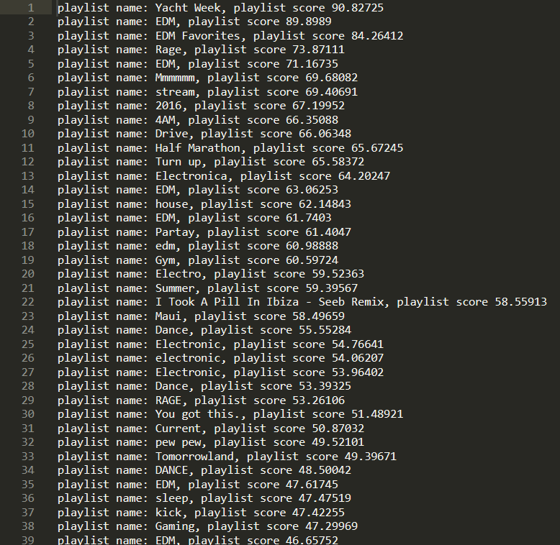
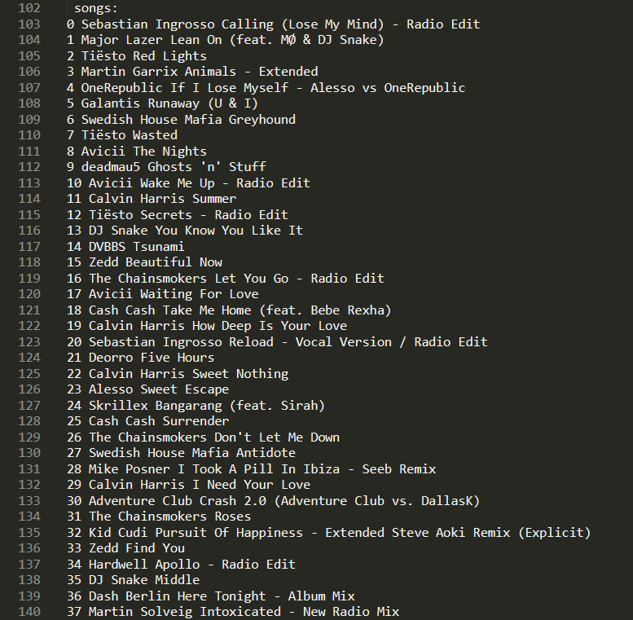

Slide 10
